Slide 1
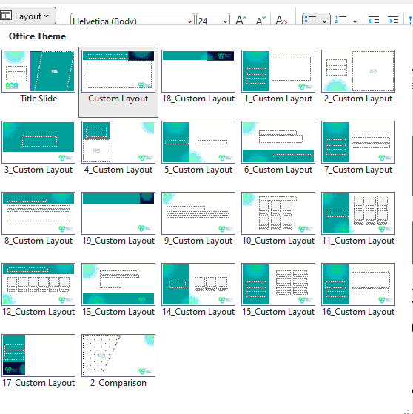
HOW TO USE THIS TEMPLATE
SELECT YOUR COVER SLIDE
  Let the GEO Team know if a design for your city is missing from the pack
KEEP THE GEO INTRODUCTION AND EVENT UPDATE SLIDES
  Each meeting should feature an introduction to GEO, benefits of joining as a member and details of future events for all newcomers
ADD YOUR CONTENT
  Use the slide templates in the Layout feature in the top menu to build your presentation deck
CONTACT THE GEO TEAM WITH ANY QUESTIONS
  We’re here to support you with any questions and to provide the marketing support
  you need to ensure a successful event!
  THANK YOU FOR SUPPORTING GEO!

Slide 2

WELCOME TO THE ATLANTA CHAPTER MEETING

Slide 3

WELCOME TO THE BELGIUM CHAPTER MEETING

Slide 4

WELCOME TO THE BOSTON CHAPTER MEETING

Slide 5

WELCOME TO THE COLARADO CHAPTER MEETING

Slide 6

WELCOME TO THE NORTHERN CALIFORNIA CHAPTER MEETING

Slide 7

WELCOME TO THE GREATER CHINA CHAPTER MEETING

Slide 8

WELCOME TO THE DACH CHAPTER MEETING

Slide 9

WELCOME TO THE FINLAND CHAPTER MEETING

Slide 10

WELCOME TO THE FRANCE CHAPTER MEETING

Slide 11

WELCOME TO THE INDIA CHAPTER MEETING

Slide 12

WELCOME TO THE ISRAEL CHAPTER MEETING

Slide 13

WELCOME TO THE ITALY CHAPTER MEETING

Slide 14

WELCOME TO THE MELBOURNE CHAPTER MEETING

Slide 15

WELCOME TO THE NEW YORK CHAPTER MEETING

Slide 16

WELCOME TO THE SINGAPORE CHAPTER MEETING

Slide 17

WELCOME TO THE SWISS ROMANDIE CHAPTER MEETING

Slide 18

WELCOME TO THE SYDNEY CHAPTER MEETING

Slide 19

WELCOME TO THE TEXAS CHAPTER MEETING

Slide 20

WELCOME TO THE TORONTO CHAPTER MEETING

Slide 21

WELCOME TO THE UK AND CHANNEL ISLANDS CHAPTER MEETING

Slide 22






WHAT MAKES
GEO
SPECIAL?
IN NUMBERS
COMMUNITY
RESOURCES
Ever-evolving member driven resources that meet your professional and personal development needs.
Expert, cost-effective industry resources
+5k
individual members across the globe connected by GEO
Partner with global, reputable and world-class peers and suppliers, when and where it suits you.
A network of trusted industry partners
GEO IS THE LEADING NON-PROFIT GLOBAL SHARE OWNERSHIP COMMUNITY
+60
Member countries accessing GEO’s
events and resources
We are focused on promoting share ownership for the benefit of employees, companies and communities
SIMPLICITY
RECOGNITION
+3
Global share plan industry individual and corporate recognition programs
Access the information, people or resources you need quickly and easily, in a place that works for you.
Instant, easy 24/7 access
Reward and recognition programmes for individuals and companies.
Elevating the industry’s best
+25
years of serving the global share plan industry

Slide 23

CLICK TO PLAY VIDEO
OUR NEW BRAND

Slide 24

WHY JOIN GEO?
GEO IS YOUR PARTNER IN ELEVATING YOUR EMPLOYEE AND EXECUTIVE SHARE PLANS AND ACHIEVING YOUR CAREER AMBITIONS.
GEO provides the tools and solutions to take
action today and make a world of difference
With employee share ownership.
WE MAKE IT EASY TO ACCESS THE RIGHT PEOPLE AND INFORMATION
Global share plan and executive compensation education
Plan strategy and design
Global and multi-national best practices and benchmarking
The latest survey data, trends, innovations, and recommendations
Strong global network of equity and executive compensation leaders, decision makers, innovators, academics, experts and professionals

Slide 25



SHAPING THE FUTURE OF
SHARE OWNERSHIP
Read industry news, explore technical updates, access ideas on global employee compensation innovation, and find ways to connect.
Surveys and reports
Articles and insights
News and updates
Stay ahead through ever-evolving member driven resources that meet your professional and personal development needs.
Online learning resources
Courses
On-demand webcasts
Learn from and develop relationships with other issuers and providers around the world and in your local region.
Member directory
Online chapter resources
Discussions, blogs and articles
DATA AND INSIGHTS
LEARNING AND DEVELOPMENT
GLOBAL COMMUNITIES

Slide 26



RECEIVE THE RECOGNITION YOU DESERVE
CELEBRATING THE GLOBAL SHARE PLAN INDUSTRY’S BEST AND BRIGHTEST SINCE 2002
OUR FELLOWS ARE SELECTED FOR THEIR CONTRIBUTIONS TO THE GLOBAL EQUITY INDUSTRY
A CAREER DEVELOPMENT AND THOUGHT LEADERSHIP PROGRAM FOR EMERGING PRACTITIONERS
Individual and corporate awards across 10 categories
Take part in GEO’s Excellence in Global Share Plans thought leadership program
Apply October to January
Winners announced at GEO’s annual conference each April
Fellow Global Equity (FGE) designation
Access to Fellows events
Discounts for GEO events
Lifetime membership to GEO post-retirement
Apply year round, selections on 31 January, 30 June and 31 October
Two-year individual GEO membership with full GEOLearn access
Free registration and speaker slot at GEO’s conference in 2027
Free access to regional chapter and virtual events
Peer networking and participation in regular skills sessions and thought-leadership project
Apply year round, selections 1 August

Slide 27







UPCOMING EVENTS
INDUSTRYLEADER
EMERGINGLEADER
Members vote for the GEO Board
20 May – 4 June 2025
Apply to become a GEO Fellow
By 30 June 2025
Apply to become a Future Leader
By 1 August 2025
An introductory course for emerging equity professionals
Virtual: October 2025
2025 Regional Events
18 September - NorCal Forum, San Mateo
12 November – PERE, London, UK
10 December – East Coast, Boston
Join our 27th Annual Conference
Austin, Texas: 21 - 23 April 2026
Celebrate at the GEO Awards
Austin, Texas: 22 April 2026
Visit the GEO website for webcasts, event information and to register >>> globalequity.org/event-calendar

Slide 28







350+
SENIOR-LEVEL GLOBAL ATTENDEES
JOIN US AT OUR
24TH ANNUAL
CONFERENCE
25 YEARS
GEO AWARDS

Slide 30
Add your content slides from this point forward

Slide 31
THANK YOU FOR ATTENDING

