Slide 2
THANK YOU FOR SPEAKING AT EAST COAST 2025!
Here’s some important information
Please use this widescreen 16:9 template for your slides. More slide options can be found in the slide master.
Session timings are below and include Q&A:
  Panel presentation – 60 minutes
  Roundtable discussion – 45 minutes
Sessions may be video and/or audio recorded and published to GEO’s website.
Provider company information may not be included, only issuer company descriptions where such information is integral to the case study presented.
All sessions must have a minimum of 3 engagement questions – see slide 8 for details.
GEO reserves the right to modify your session title. Any subsequent changes must receive prior approval from GEO.
WELCOME SPEAKERS!
IMPORTANT SPEAKER ACTION ITEMS
Deadline: 21 November 2025
Register via the conference registration page on myGEO ASAP, ideally by 30 September 2025.
All speakers are deemed to have accepted GEO’s speaker terms and conditions.
Provide your final presentation slides, a bio and high-resolution headshot via our website or directly to Kaitlyn Hallman.
These may be used on GEO’s website, marketing and social media.

Slide 3
Session Title
Session Title Sub-header
Date

Slide 4



DIAMOND SPONSOR
SUPPORTING SPONSORS

Slide 5

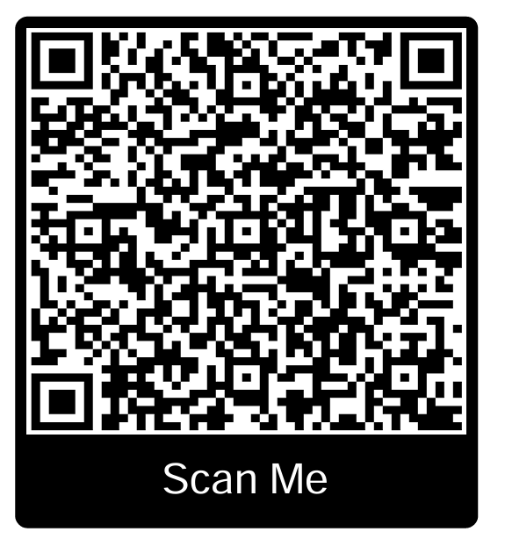


How to earn Continuing Education Credit for this session
You MUST scan the QR code at the start and end of each session to be eligible for CPE
CHECKING INTO THE SESSIONS
Visit the CEP's online portal to record your credit

Slide 6
OUR
SPEAKERS
Speaker Name
COMPANY
Speaker Name
COMPANY
Speaker Name
COMPANY

Slide 7
Section Divider
Font: Arial 36pt bold

Slide 8
Slide Heading Font: Arial 36pt
Sub Headlines – Arial Bold 20pt
Body copy set in Arial Regular 18pt using a single line space. Paragraph after spacing is 12pt.
Body copy set in Arial Regular 18pt with a line spacing set to Single. Each paragraph should have space after set to 12pt.
Body copy set in Arial Regular 18pt with a line spacing set to Single. Each paragraph should have space after set to 12pt.

Slide 9
Body Copy Slide
Body copy set in Arial Regular 18pt using a single line space. Paragraph after spacing is 12pt.
We can highlight important areas by using Arial Bold and adding a highlight colour (blue-green).

Slide 10
ENGAGEMENT ACTIVITY
Ask a question to engage the audience – there must be three engagement questions throughout the presentation.
.
Response 1
Response 2
Response 3
Response 4

Slide 11
Speaker Name
Speaker Name
Company
Company
email@address.com
email@address.com
Speaker Name
Speaker Name
Company
Company
email@address.com
email@address.com
ANY QUESTIONS?
Speaker Name
Speaker Name
Company
Company
email@address.com
email@address.com

Slide 12
How to earn Continuing Education Credit for this session
YOU MUST SCAN THE QR CODE BEFORE LEAVING TO BE ELIGIBLE FOR CPE CREDIT.
REMEMBER TO CHECK-OUT!

Slide 13
THANK YOU FOR ATTENDING
CPE credits are provided for live events and webcasts only. Please visit the Continuing Education and Event Policies on our website for more information.
Please provide your feedback on this session via the event app.
  A PERE event survey will be shared after the event – thank you for helping to improve future events by providing your feedback!
WE HOPE YOU ENJOYED THIS SESSION

