Slide 1
THANK YOU FOR SPEAKING AT GEO AUSTIN! Here’s some important information
Please use this template for your slides. More slide options can be found in the slide master. Do not change the size from widescreen 16:9
Session durations, including Q&A, are as follows:
Panel sessions must have 3+ engagement questions for CPE compliance – see slide 7 for details – 60 minutes
Roundtable sessions must have 3+ engagement questions for CPE compliance – see slide 7 for details – 50 minutes
Focus sessions – 30 minutes
Lightening sessions – 15 minutes
Sessions may be video and/or audio recorded and published to GEO’s website or other marketing channels.
Any modifications to the title of your session must be approved by GEO beforehand.
Provider company information may not be included, only issuer company descriptions where such information is integral to the case study presented.
All speakers must be registered with fees paid in full to attend the conference.
WELCOME SPEAKERS!
IMPORTANT SPEAKER ACTION ITEMS
BEFORE 23 JANUARY
Register for the conference to save $300. All speakers are deemed to have accepted GEO’s speaker terms and conditions.
Provide a bio and high-resolution headshot via our website or by email to Kaitlyn Hallman. These may be used on GEO’s website, marketing and social media.
BEFORE 4 APRIL
Provide your final presentation slides via our website or by email to Kaitlyn Hallman.

Slide 3
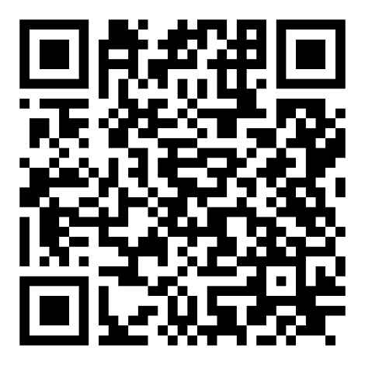
Date
CHECK IN TO THIS SESSION IN YOUR EVENT APP FOR CPE CREDIT

Slide 4

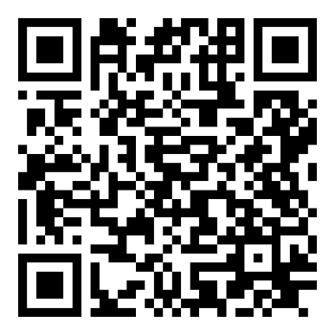


How to earn Continuing Education Credit for this session
CHECK IN – IN THE APP Go to the session and tap ’Check In’
CHECK OUT – IN THE APP
Tap ‘Checked in. Would you like to check out?’ at the end of the session for a time stamp
REMEMBER TO CHECK IN TO THIS SESSION
Visit the CEP's online portal to record your credit
THIS SESSION MAY BE RECORDED

Slide 5


OUR
SPEAKERS
CLICK TO EDIT COMPANY
CLICK TO EDIT COMPANY
CLICK TO EDIT COMPANY

Slide 6
Slide Heading Font: Arial 36pt
Sub Headlines – Arial Bold 20pt
Body copy set in Arial Regular 18pt using a single line space. Paragraph after spacing is 12pt.
Add text
Add text
Body copy set in Arial Regular 18pt with a line spacing set to Single. Each paragraph should have space after set to 12pt.

Slide 7
ENGAGEMENT ACTIVITY
Ask a question to engage the audience – there must be three engagement questions throughout the presentation.
Response 1
Response 2
Response 3
Response 4

Slide 8
Body Copy Slide
Body copy set in Arial Regular 18pt using a single line space. Paragraph after spacing is 12pt.
We can highlight important areas by using Arial Bold and adding a highlight color (orange).

Slide 11
Section Divider Font: Arial 36pt Bold

Slide 12
Speaker Name
Speaker Name
Company
Company
email@address.com
email@address.com
Speaker Name
Speaker Name
ANY QUESTIONS?
Company
Company
email@address.com
email@address.com
Speaker Name
Speaker Name
Company
Company
email@address.com
email@address.com

Slide 13
WE HOPE YOU ENJOYED THIS SESSION
COLLECTING CPE CREDITS? REMEMBER TO CHECK OUT OF THIS SESSION IN YOUR EVENT APP
CPE credits are provided for live events and webcasts over 50 minutes only.
GEO must prove your attendance – no credits will be awarded unless you have checked in and checked out of this session.
Please visit the Continuing Education and Event Policies on our website for more information.
PLEASE LET US KNOW WHAT YOU THINK!
Please provide your feedback on this session via the app.
A GEO Austin survey will be shared after the event – thank you for helping to improve future events by providing your feedback!
Ideas for future topics? Email us at events@globalequity.org
THANK YOU FOR ATTENDING

