Slide 1
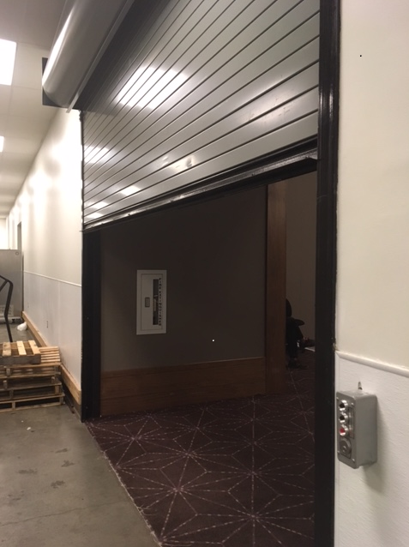
4th floor Garage Door: 12ft across X 9.5ft tall
(144CMx119CM)

