Slide 1
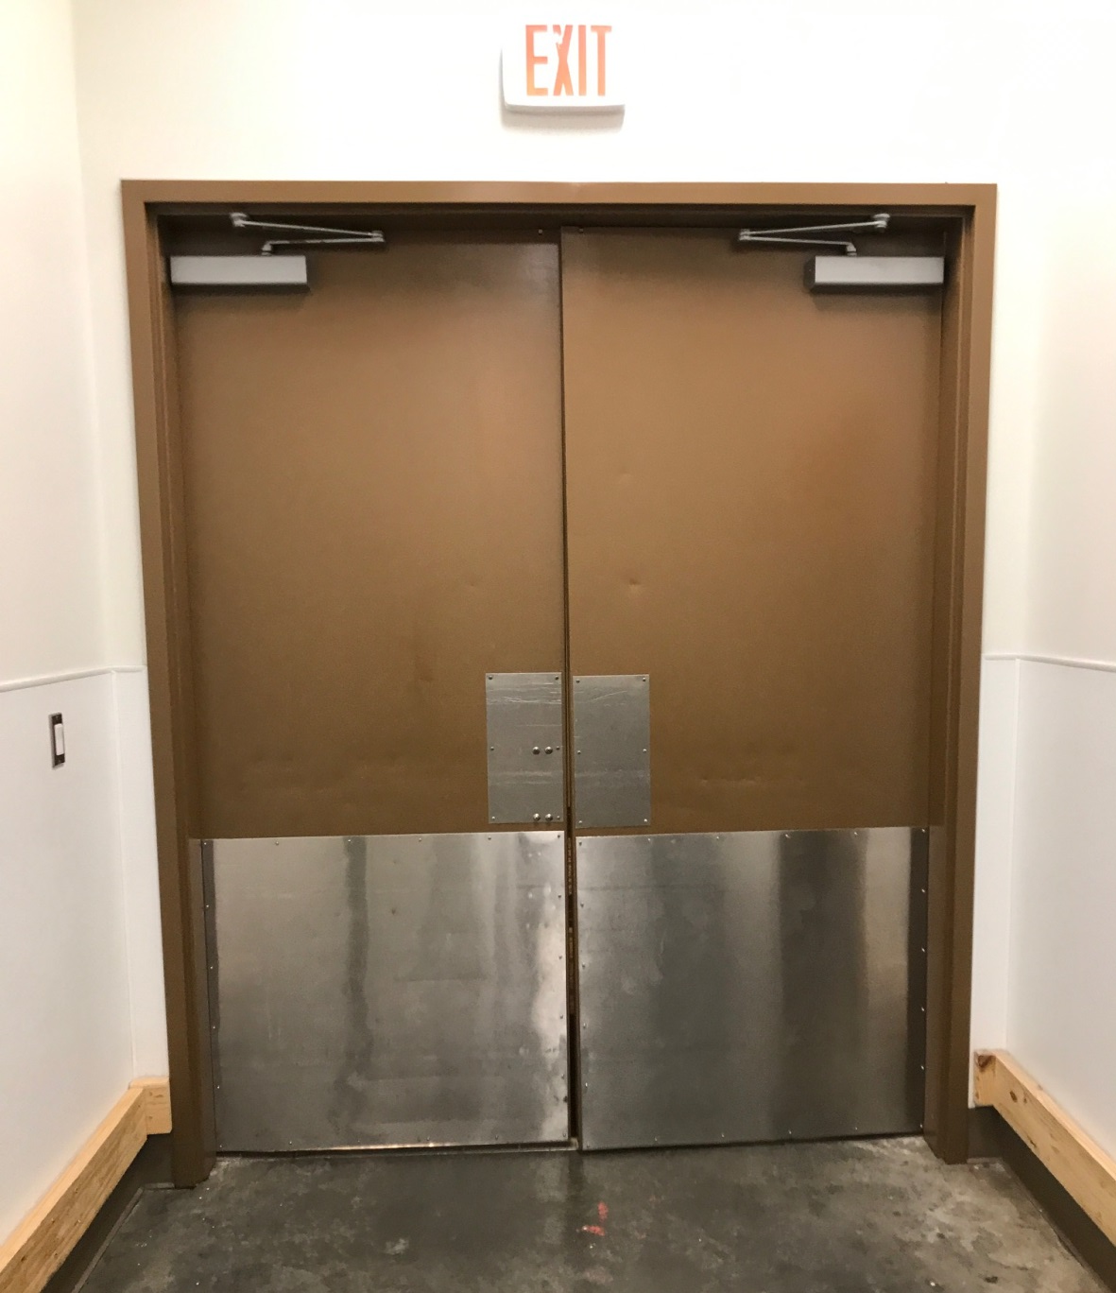
6ft. 5in. wide X 7ft. 10in. high
Opens across from restrooms and guest elevators on 4th floor

Slide 2
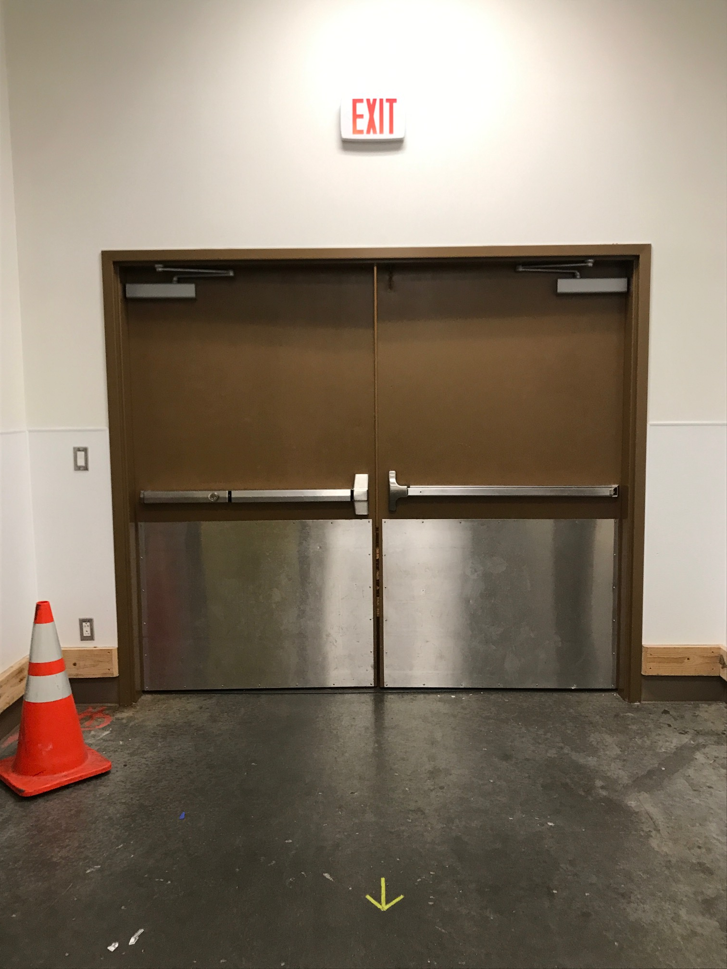
7ft. 11n. wide X 6ft. 11in. high
Doors next to Salon 1 and across from 407 are the same dimensions

