Slide 1
ALL CHAPTERS:
COVER SLIDE AND FOLLOWING HEADLINE SLIDE

Slide 2
Add Headline

Slide 3


Slide 4

ADD HEADLINE
FOR NEW YORK
HERE

Slide 5


Slide 6

ADD HEADLINE FOR UK AND CHANNEL ISLANDS

Slide 7


Slide 8

ADD HEADLINE FOR TORONTO HERE

Slide 9


Slide 10

ADD HEADLINE FOR SYDNEY HERE

Slide 11


Slide 12

ADD HEADLINE FOR ATLANTA HERE

Slide 13


Slide 14

ADD HEADLINE FOR BELGIUM HERE

Slide 15


Slide 16

ADD HEALDINE FOR BOSTON HERE

Slide 17


Slide 18

ADD HEADLINE FOR BRAZIL HERE

Slide 19


Slide 20

ADD HEADLINE FOR COLARADO HERE

Slide 21


Slide 22

ADD HEADLINE FOR CALIFORNIA

Slide 23


Slide 24

ADD HEADLINE FOR CHINA HERE

Slide 25


Slide 26


Slide 27

ADD HEADLINE FOR NORDIC HERE

Slide 28


Slide 29

ADD HEADLINE FOR SWEDEN HERE

Slide 30


Slide 31

ADD HEADLINE FOR FRANCE HERE

Slide 32


Slide 33

ADD HEALDINE FOR UTAH
HERE

Slide 34


Slide 35

ADD HEALDINE FOR INDIA HERE

Slide 36


Slide 37
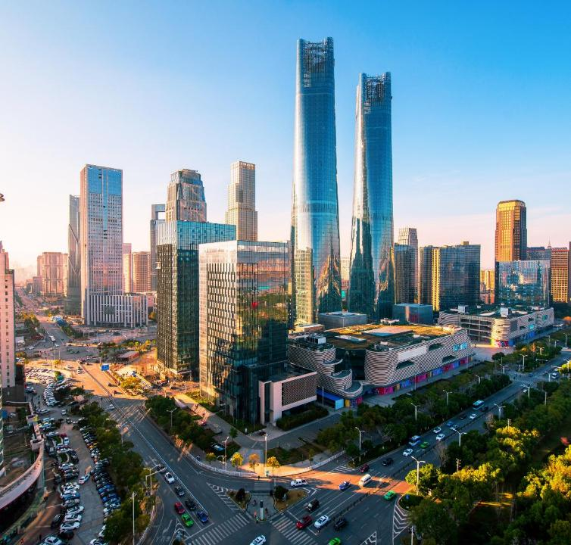
ADD HEADLINE FOR ISRAEL HERE

Slide 38


Slide 39

ADD HEADLINE FOR ITALY
HERE

Slide 40


Slide 41

ADD HEADLINE FOR MELBOURNE HERE

Slide 42


Slide 43

ADD HEADLINE FOR MID WEST HERE

Slide 44


Slide 45
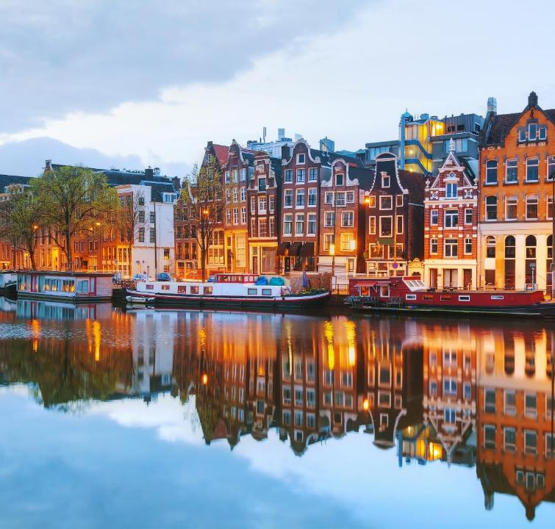
ADD HEADLINE FOR NETHERLANDS HERE

Slide 46


Slide 47

ADD HEADLINE FOR PACIFIC NORTH WEST HERE

Slide 48


Slide 49

ADD HEADLINE FOR SINGAPORE HERE

Slide 50


Slide 51

ADD HEADLINE FOR SOUTH WEST HERE

Slide 52


Slide 53

ADD HEALDINE FOR SPAIN HERE

Slide 54


Slide 55

ADD HEALDINE FOR SWISS ROMANDIE HERE

Slide 56


Slide 57

ADD HEADLINE FOR HOUSTON TEXAS HERE

Slide 58


Slide 59

ADD HEADLINE FOR AUSTRIA HERE

Slide 60


Slide 61

ADD HEADLINE FOR DENMARK HERE

Slide 62


Slide 63

ADD HEADLINE FOR GERMANY HERE

Slide 65

ADD HEADLINE FOR CALIFORNIA HERE

Slide 66
CONTENT DECK

Slide 67

ADVERTISING HEADLINE BE PLACED IN THIS AREA

Slide 68

UPCOMING EVENTS & INITIATIVES
KEY DATES, DEADLINES AND OPPORTUNITIES FOR OUR GLOBAL COMMUNITY
GEO FELLOWSHIP
GET THE RECOGNITION
YOU DESERVE
REGISTER BY
30 JUNE 2026
REGIONAL EVENT
FALL 2026: EAST COAST,
LOCATION TBC
DEADLINE
30 JUNE 2026
FELLOW OF
GLOBL
EQUITY
NORCAL
REGIONAL
EVENT
GEO ELEVATE
JOIN AS A MENTOR OR MENTEE
DEADLINE
30 JUNE 2026
28TH ANNUAL
CONFERENCE
19-21 APRIL 2027
COPENHAGEN DENMARK
DEADLINE
30 JUNE 2026
SHARE
LEARN
DELIVER
GEO
ANNUAL
CONFERENCE
FUTURE
LEADER
FUTURE LEADER
APPLY FOR THE NEXT CLASS
DEADLINE
30 JUNE 2026
GEO
ANNUAL
AWARDS
ANNUAL AWARDS CEREMONY
20 APRIL 2027
DEADLINE
30 JUNE 2026
DEADLINE
30 JUNE 2026
GEO CONNECT
WEBINAR
ADD DESCRIPTION HERE
DEADLINE
30 JUNE 2026
CONNECTED
EQUITY
CONNECTED EQUITY
A JOINT SHARE PLAN FORUM
11 JUNE DUBLIN, IRELAND
GEO
GLOBAL
WEBCAST
REGIONAL EVENT
PERE LONDON UK,
12 NOVEMBER 2026
DEADLINE
30 JUNE 2026
REGIONAL EVENT
HERE
ADD DESCRIPTION HERE
DEADLINE
30 JUNE 2026
PERE
REGIONAL
EVENT
EVENT
NAME
HERE
VISIT THE GEO WEBSITE FOR WEBCASTS, EVEN INFORMATION AND TO REGISTER. globalequity.og/event-calandar

Slide 69





Ten categories
Recognition on a global stage
Apply October to January
Winners announced at GEO Annual
OUR FELLOWS ARE SELECTED FOR THEIR CONTRIBUTIONS TO THE GLOBAL EQUITY INDUSTRY
Ten categories
Recognition on a global stage
Apply October to January
Winners announced at GEO Annual
A CAREER DEVELOPMENT AND THOUGHT LEADERSHIP PROGRAM FOR RISING STAR PRACTITIONERS
WE HELP YOU TO ACHIEVE YOUR CAREER AMBITIONS
DATA AND INSIGHTS
LEARNING AND DEVELOPMENT
GEO offers unmatched benefits for equity professionals, providing the tools, connections, and expertise needed to thrive in a complex and dynamic industry.
Whether you’re looking to enhance your skills, expand your network, or gain recognition in the equity compensation field, GEO is your trusted partner for success.
BECOME A MENTOR AND/OR MENTEE FOR A UNIQUE OPPORTUNITY TO CONNECT, GROW AND THRIVE
Fellow of Global Equity (FGE) designation
Fellows-only events and GEO event discounts
Lifetime membership to GEO, post-retirement
Apply year round. 31 Jan, 30 June, 31 Oct
CELEBRATING THE GLOBAL SHARE PLAN INDUSTRY’S BEST AND BRIGHTEST SINCE 2002
Ten categories
Recognition on a global stage
Apply October to January
Winners announced at GEO Annual

Slide 70





Read industry news, explore technical updates access ideas on global employee compensation innovation, and find ways to connect.
Stay ahead through ever-evolving member driven resources that meet your professional and personal development needs.
WE MAKE IT EASY TO ACCESS THE RIGHT PEOPLE AND INFORMATION
Surveys and reports
Articles and insights
News and updates
Online learning resources
Courses
On-demand webcasts
DATA AND INSIGHTS
LEARNING AND DEVELOPMENT
Global equity and compensation education
Strategic plan design and governance
International benchmarking and best practice
Industry insights, trends and innovation
Global network of leaders, experts and decision-makers
Learn from and develop relationships with other issuers and providers around the world and in your local region.
YOUR GATEWAY TO GLOBAL INSIGHTS, PROFESSIONAL DEVELOPMENT AND MEANINGFUL INDUSTRY CONNECTIONS.
Surveys and reports
Articles and insights
News and updates
GLOBAL COMMUNITIES

Slide 71

ICON SUITE
TO ADD AN ICON TO YOUR DECK SIMPLY COPY THE ICON YOUR REQUIRE FROM THE ICON SET AND PASTE IT INTO YOUR POWERPOINT PAGE. YOU CAN ALSO CHANGE THE COLOUR OF THE ICON IN YOUR OPTIONS LIBRARY

Slide 82
Add Headline to This Area
Headline Here

Slide 83
CLICK HERE TO ADD HEAD

Slide 93
ADD ADVERTISING HEADLINE IN THIS AREA

